Slide 1
Optics
Inverse problems in imaging, spring 15
Guy Satat
Some slides are taken from a similar class by Chris Barsi

Slide 2
What is light ?
Quantum optics
Electromagnetics
Waves
Rays

Slide 3
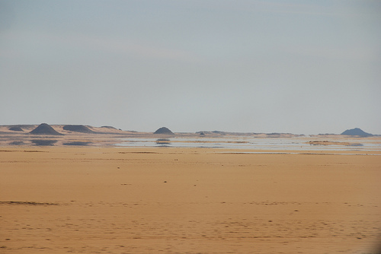

Slide 4
Electromagnetism

Slide 5
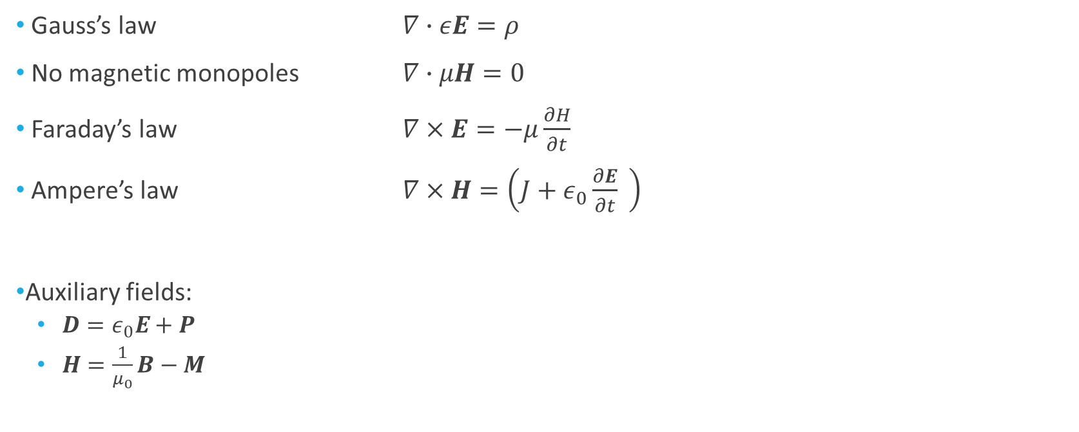
Maxwell’s Equations
Gauss’s law $∇∙εE=ρ$
No magnetic monopoles $∇∙μH=0$
Faraday’s law $∇×E=−μ\frac{∂H}{∂t}$
Ampere’s law $∇×H=\left(J+ε_{0}\frac{∂E}{∂t} \right)$
Auxiliary fields:
$D=ε_{0}E+P$
$H=\frac{1}{μ_{0}}B−M$

Slide 6
Maxwell’s Equations
Gauss’s law $∇∙εE=ρ$
No magnetic monopoles $∇∙μH=0$
Faraday’s law $∇×E=−μ\frac{∂H}{∂t}$
Ampere’s law $∇×H=\left(J+ε_{0}\frac{∂E}{∂t} \right)$
Auxiliary fields:
$D=ε_{0}E+P$
$H=\frac{1}{μ_{0}}B−M$
Towards the Wave Equation

Slide 7
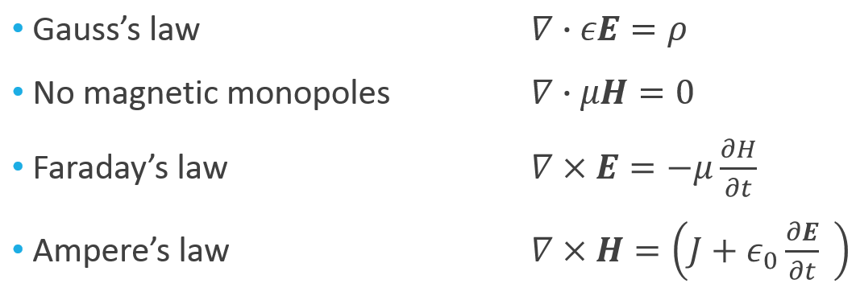
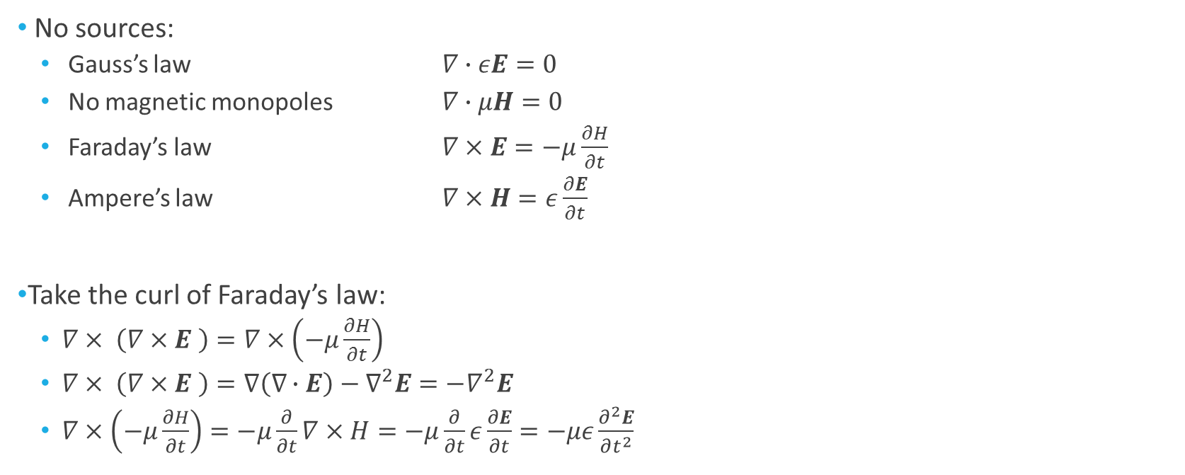
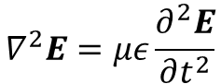
Towards the Wave Equation
No sources:
Gauss’s law $∇∙εE=0$
No magnetic monopoles $∇∙μH=0$
Faraday’s law $∇×E=−μ\frac{∂H}{∂t}$
Ampere’s law $∇×H=ε\frac{∂E}{∂t}$
Take the curl of Faraday’s law:
$∇× \left(∇×E \right)=∇×\left(−μ\frac{∂H}{∂t}\right)$
$∇× \left(∇×E \right)=∇\left(∇∙E\right)−∇^{2}E=−∇^{2}E$
$∇×\left(−μ\frac{∂H}{∂t}\right)=−μ\frac{∂}{∂t}∇×H=−μ\frac{∂}{∂t}ε\frac{∂E}{∂t}=−με\frac{∂^{2}E}{∂t^{2}}$
$$∇^{2}E=με\frac{∂^{2}E}{∂t^{2}}$$

Slide 8
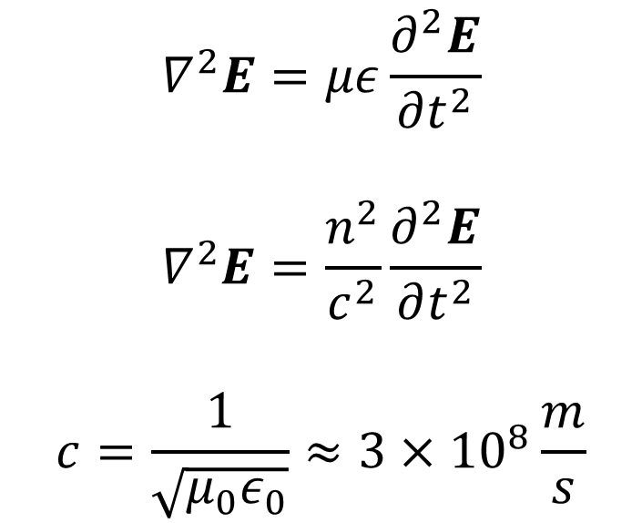
The wave equation
$$∇^{2}E=με\frac{∂^{2}E}{∂t^{2}}$$
$$∇^{2}E=\frac{n^{2}}{c^{2}}\frac{∂^{2}E}{∂t^{2}}$$
$$c=\frac{1}{\sqrt{μ_{0}ε_{0}}}≈3×{10}^{8}\frac{m}{s}$$

Slide 9
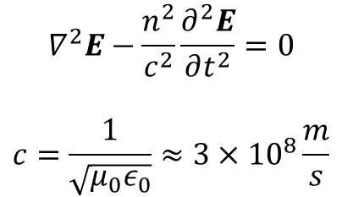
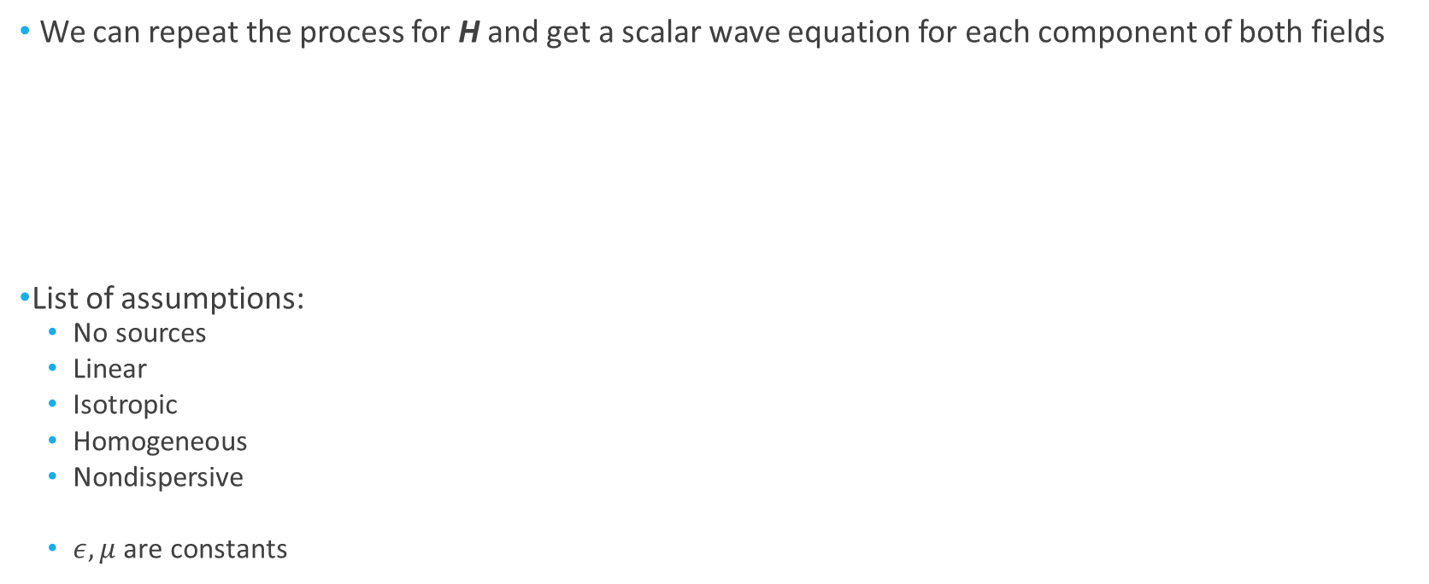
The wave equation
We can repeat the process for H and get a scalar wave equation for each component of both fields
List of assumptions:
No sources
Linear
Isotropic
Homogeneous
Nondispersive
$ε, μ$ are constants
$$∇^{2}E−\frac{n^{2}}{c^{2}}\frac{∂^{2}E}{∂t^{2}}=0$$
$$c=\frac{1}{\sqrt{μ_{0}ε_{0}}}≈3×{10}^{8}\frac{m}{s}$$

Slide 10
Wave Optics
Let’s assume a given polarization

Slide 11
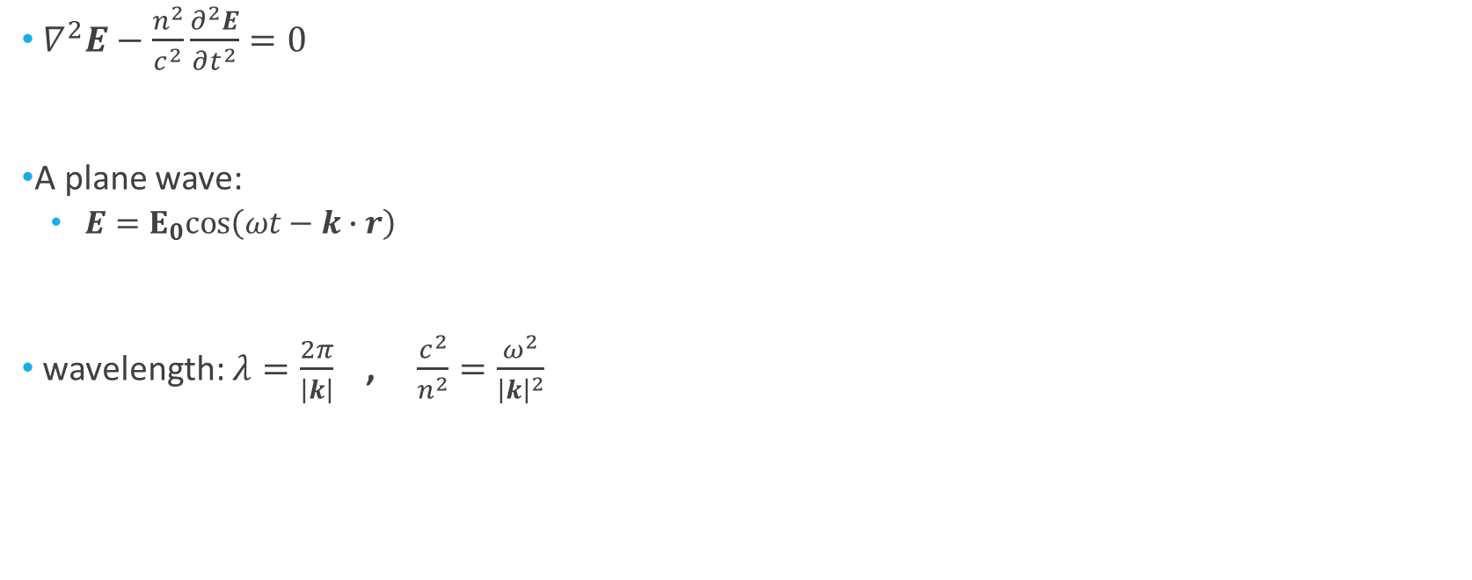
A wave solution
$∇^{2}E−\frac{n^{2}}{c^{2}}\frac{∂^{2}E}{∂t^{2}}=0$
A plane wave:
$E=E_{0}cos\left(ωt−k∙r\right)$
wavelength: $λ=\frac{2π}{\left|k\right|}$ , $\frac{c^{2}}{n^{2}}=\frac{ω^{2}}{{\left|k\right|}^{2}}$

Slide 12
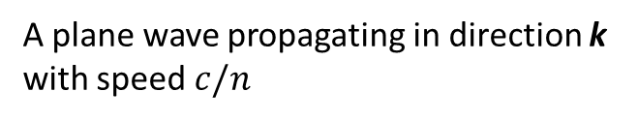
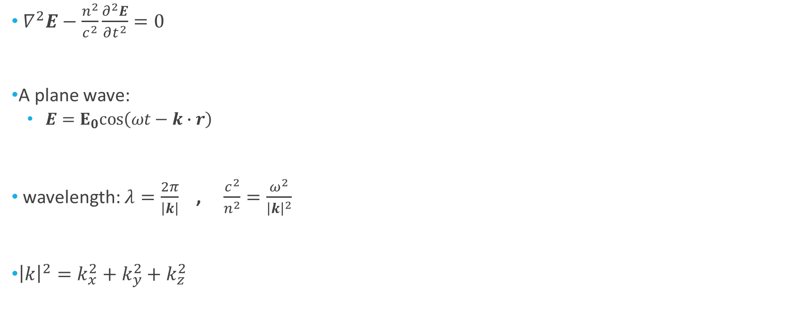
A wave solution
$∇^{2}E−\frac{n^{2}}{c^{2}}\frac{∂^{2}E}{∂t^{2}}=0$
A plane wave:
$E=E_{0}cos\left(ωt−k∙r\right)$
wavelength: $λ=\frac{2π}{\left|k\right|}$ , $\frac{c^{2}}{n^{2}}=\frac{ω^{2}}{{\left|k\right|}^{2}}$
${\left|k\right|}^{2}=k_{x}^{2}+k_{y}^{2}+k_{z}^{2}$
k
A plane wave propagating in direction k with speed $c/n$

Slide 13
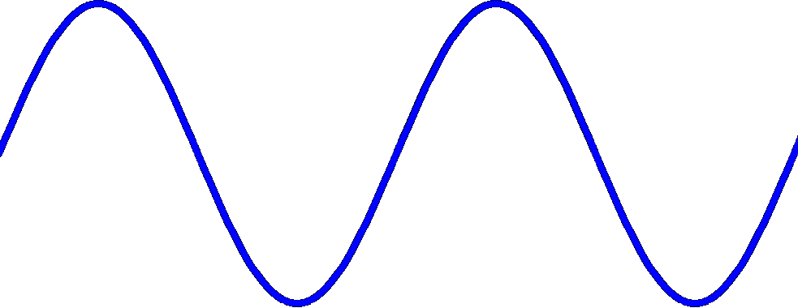
Interference
Constructive
Deconstructive
Bright
Dark

Slide 14
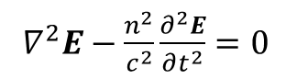
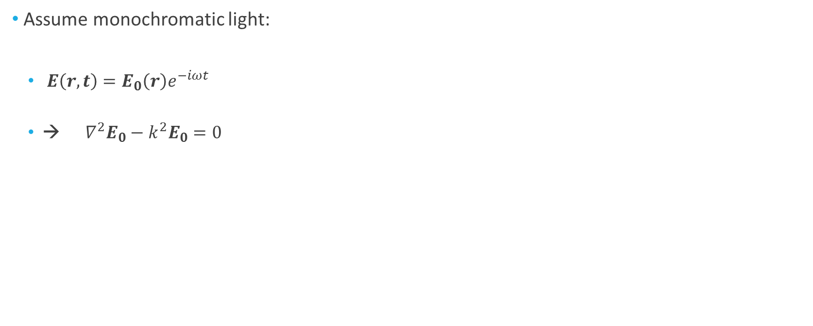
Helmholtz Equation
$∇^{2}E−\frac{n^{2}}{c^{2}}\frac{∂^{2}E}{∂t^{2}}=0$
Assume monochromatic light:
$E\left(r,t\right)=E_{0}\left(r\right)e^{−iωt}$
→ $∇^{2}E_{0}−k^{2}E_{0}=0$

Slide 15
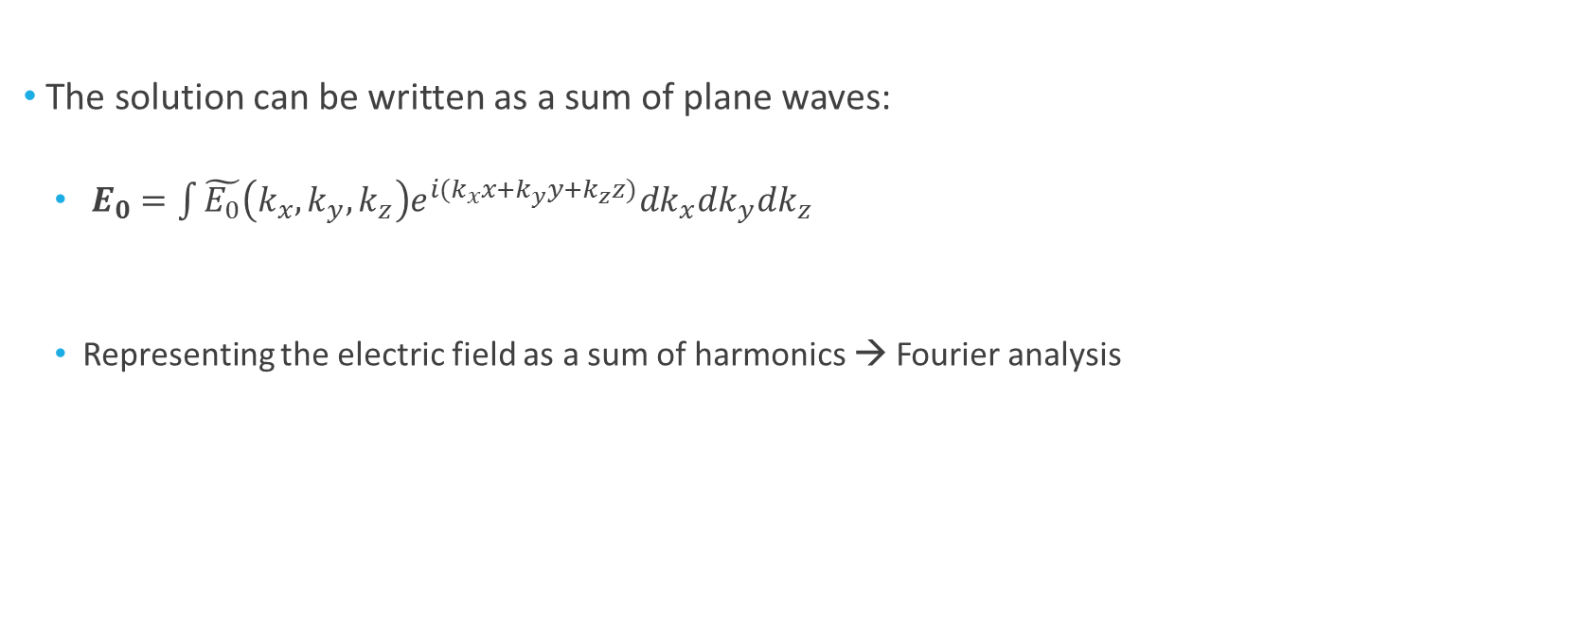
Fourier Optics
The solution can be written as a sum of plane waves:
$E_{0}=\int{\tilde{E_{0}}\left(k_{x},k_{y},k_{z}\right)e^{i(k_{x}x+k_{y}y+k_{z}z)}dk_{x}dk_{y}dk_{z}}$
Representing the electric field as a sum of harmonics → Fourier analysis

Slide 16
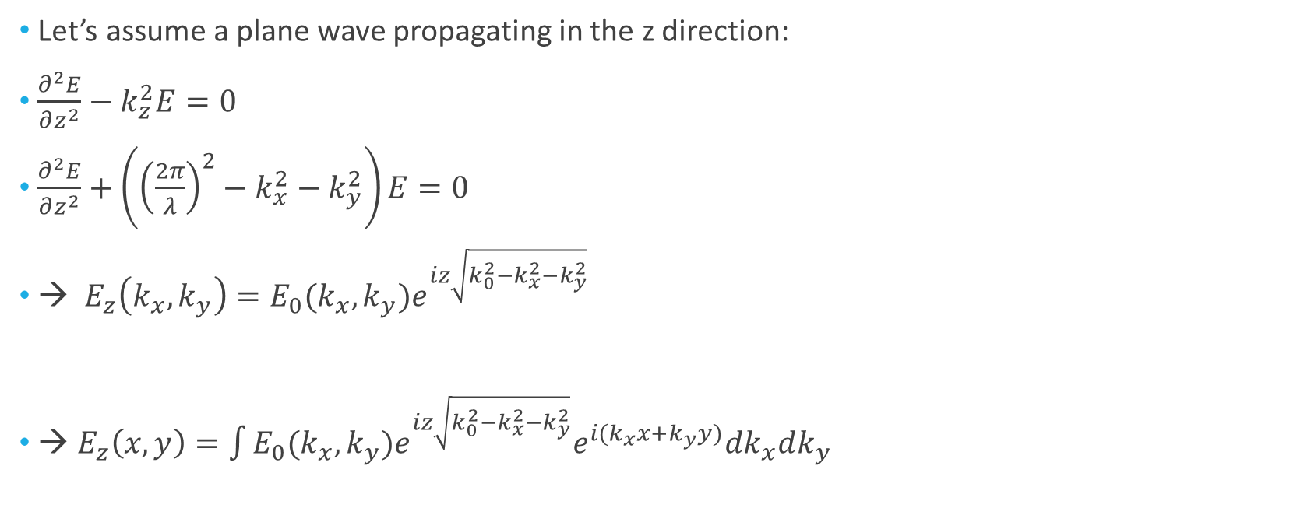
Fourier Optics
Let’s assume a plane wave propagating in the z direction:
$\frac{∂^{2}E}{∂z^{2}}−k_{z}^{2}E=0$
$\frac{∂^{2}E}{∂z^{2}}+\left({\left(\frac{2π}{λ}\right)}^{2}−k_{x}^{2}−k_{y}^{2}\right)E=0$
→ $E_{z}\left(k_{x},k_{y}\right)=E_{0}(k_{x},k_{y})e^{iz\sqrt{k_{0}^{2}−k_{x}^{2}−k_{y}^{2}}}$
→ $E_{z}\left(x,y\right)=\int{{E_{0}(k_{x},k_{y})e}^{iz\sqrt{k_{0}^{2}−k_{x}^{2}−k_{y}^{2}}}e^{i(k_{x}x+k_{y}y)}dk_{x}dk_{y}}$

Slide 17
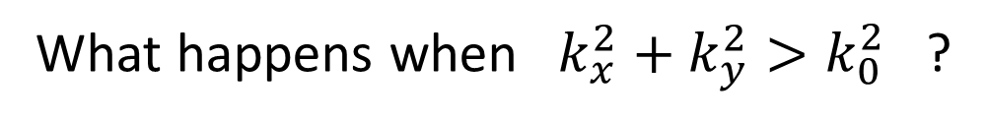
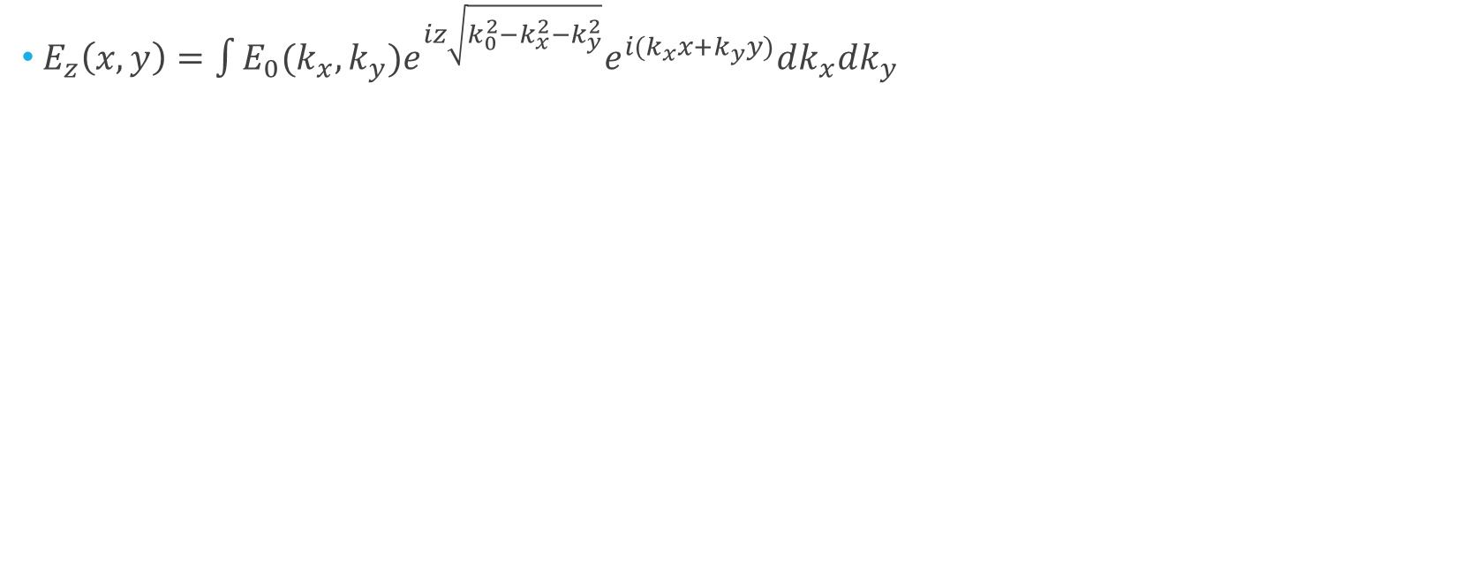
Free Space Transfer Function
$E_{z}\left(x,y\right)=\int{{E_{0}(k_{x},k_{y})e}^{iz\sqrt{k_{0}^{2}−k_{x}^{2}−k_{y}^{2}}}e^{i(k_{x}x+k_{y}y)}dk_{x}dk_{y}}$
Free space transfer function
What happens when $k_{x}^{2}+k_{y}^{2}>k_{0}^{2}$ ?

Slide 18
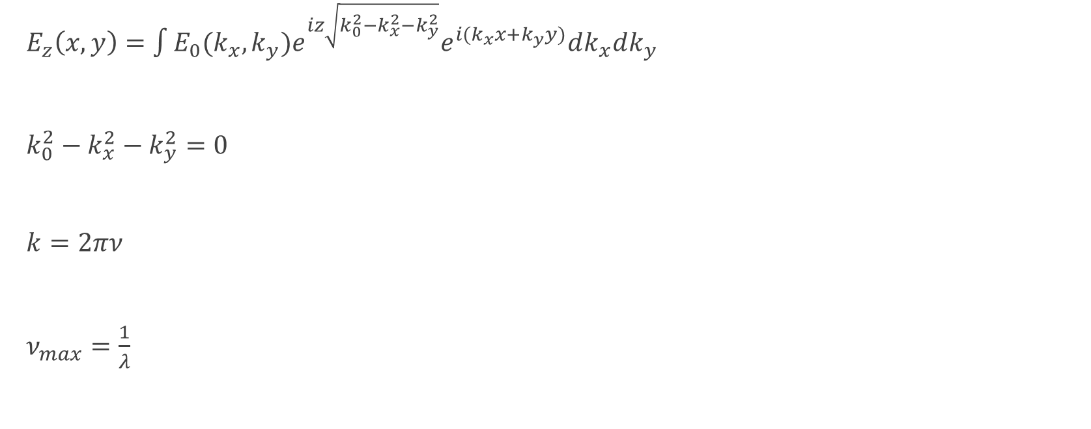
Diffraction Limit
$E_{z}\left(x,y\right)=\int{{E_{0}(k_{x},k_{y})e}^{iz\sqrt{k_{0}^{2}−k_{x}^{2}−k_{y}^{2}}}e^{i(k_{x}x+k_{y}y)}dk_{x}dk_{y}}$
$k_{0}^{2}−k_{x}^{2}−k_{y}^{2}=0$
$k=2πν$
$ν_{max}=\frac{1}{λ}$

Slide 19
Diffraction Limit
$E_{z}\left(x,y\right)=\int{{E_{0}(k_{x},k_{y})e}^{iz\sqrt{k_{0}^{2}−k_{x}^{2}−k_{y}^{2}}}e^{i(k_{x}x+k_{y}y)}dk_{x}dk_{y}}$
$k_{0}^{2}−k_{x}^{2}−k_{y}^{2}=0$
$k=2πν$
$ν_{max}=\frac{1}{λ}$
Free space is a low pass filter

Slide 20
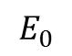
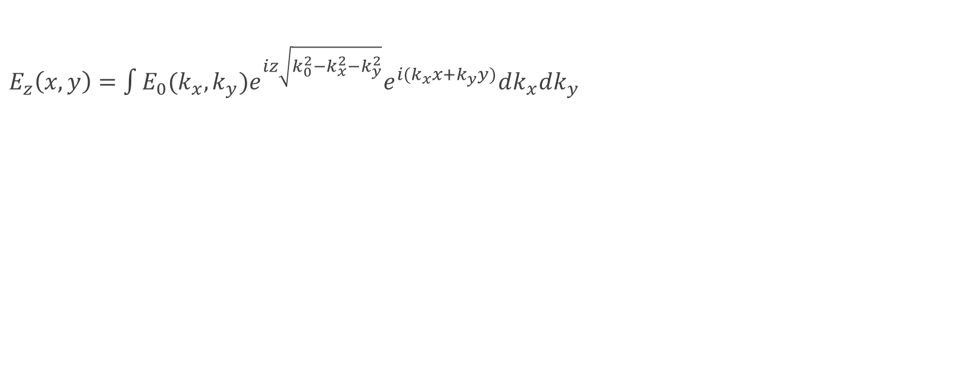
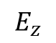
Recap – Light propagation
$E_{z}\left(x,y\right)=\int{{E_{0}(k_{x},k_{y})e}^{iz\sqrt{k_{0}^{2}−k_{x}^{2}−k_{y}^{2}}}e^{i(k_{x}x+k_{y}y)}dk_{x}dk_{y}}$
$$E_{0}$$
$$E_{z}$$
?
z=0
z=z’

Slide 21
Recap – Light propagation
$E_{z}\left(x,y\right)=\int{{E_{0}(k_{x},k_{y})e}^{iz\sqrt{k_{0}^{2}−k_{x}^{2}−k_{y}^{2}}}e^{i(k_{x}x+k_{y}y)}dk_{x}dk_{y}}$
$$E_{0}$$
$$E_{z}$$
?
That’s a hard integral…
So we approximate it
z=0
z=z’

Slide 22
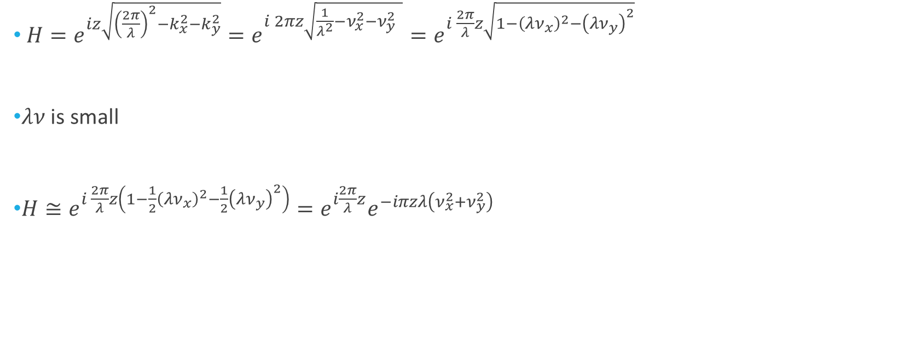
Fresnel Approximation
$H=e^{iz\sqrt{{\left(\frac{2π}{λ}\right)}^{2}−k_{x}^{2}−k_{y}^{2}}}=e^{i 2πz\sqrt{\frac{1}{λ^{2}}−ν_{x}^{2}−ν_{y}^{2} }}=e^{i \frac{2π}{λ}z\sqrt{1−{\left(λν_{x}\right)}^{2}−{\left(λν_{y}\right)}^{2}}}$
$λν$ is small
$H≅e^{i \frac{2π}{λ}z\left(1−{\frac{1}{2}\left(λν_{x}\right)}^{2}−\frac{1}{2}{\left(λν_{y}\right)}^{2}\right)}=e^{i\frac{2π}{λ}z}e^{−iπzλ\left(ν_{x}^{2}+ν_{y}^{2}\right)}$

Slide 23
Fresnel Approximation
$H=e^{iz\sqrt{{\left(\frac{2π}{λ}\right)}^{2}−k_{x}^{2}−k_{y}^{2}}}=e^{i 2πz\sqrt{\frac{1}{λ^{2}}−ν_{x}^{2}−ν_{y}^{2} }}=e^{i \frac{2π}{λ}z\sqrt{1−{\left(λν_{x}\right)}^{2}−{\left(λν_{y}\right)}^{2}}}$
$λν$ is small
$H≅e^{i \frac{2π}{λ}z\left(1−{\frac{1}{2}\left(λν_{x}\right)}^{2}−\frac{1}{2}{\left(λν_{y}\right)}^{2}\right)}=e^{i\frac{2π}{λ}z}e^{−iπzλ\left(ν_{x}^{2}+ν_{y}^{2}\right)}$
Linear phase
Square phase

Slide 24
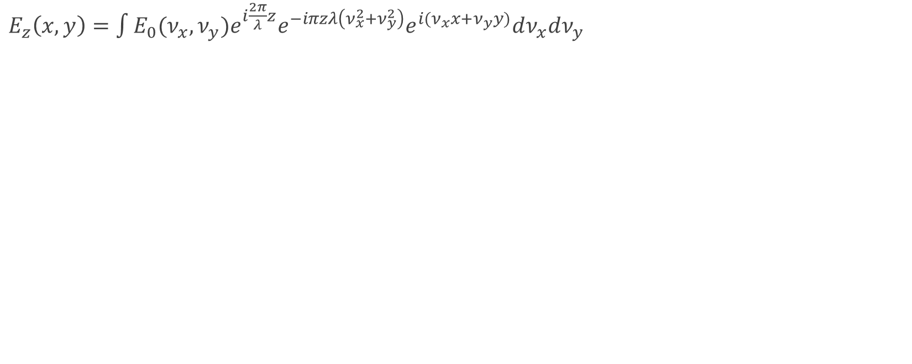
Fresnel Approximation
$E_{z}\left(x,y\right)=\int{E_{0}(ν_{x},ν_{y})e^{i\frac{2π}{λ}z}e^{−iπzλ\left(ν_{x}^{2}+ν_{y}^{2}\right)}e^{i(ν_{x}x+ν_{y}y)}dν_{x}dν_{y}}$

Slide 25
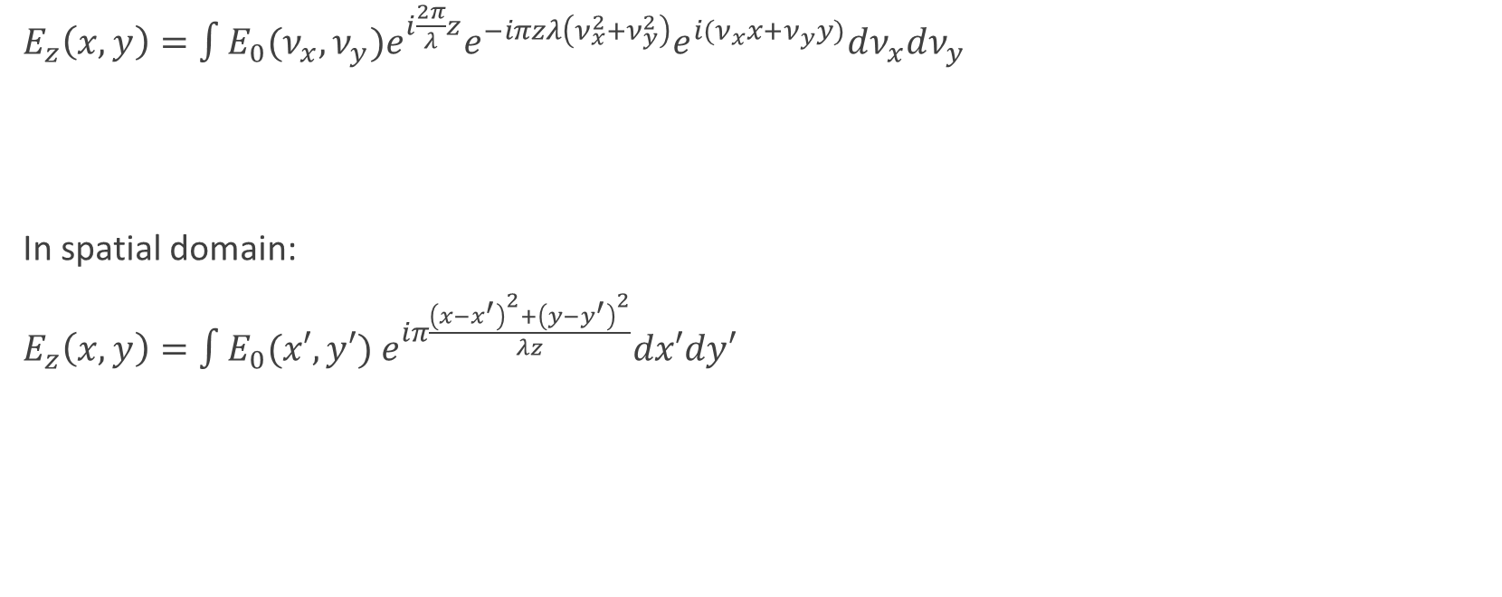
Fresnel Approximation
$E_{z}\left(x,y\right)=\int{E_{0}(ν_{x},ν_{y})e^{i\frac{2π}{λ}z}e^{−iπzλ\left(ν_{x}^{2}+ν_{y}^{2}\right)}e^{i(ν_{x}x+ν_{y}y)}dν_{x}dν_{y}}$
In spatial domain:
$E_{z}\left(x,y\right)=\int{E_{0}(x′,y′) e^{iπ\frac{{\left(x−x^{′}\right)}^{2}+{\left(y−y^{′}\right)}^{2}}{λz}}dx′dy′}$
Each point is propagated by a parabolic wave front
(Huygens principle)

Slide 26
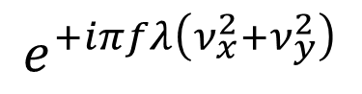
Lens Transfer Function
$$e^{+iπfλ\left(ν_{x}^{2}+ν_{y}^{2}\right)}$$

Slide 27
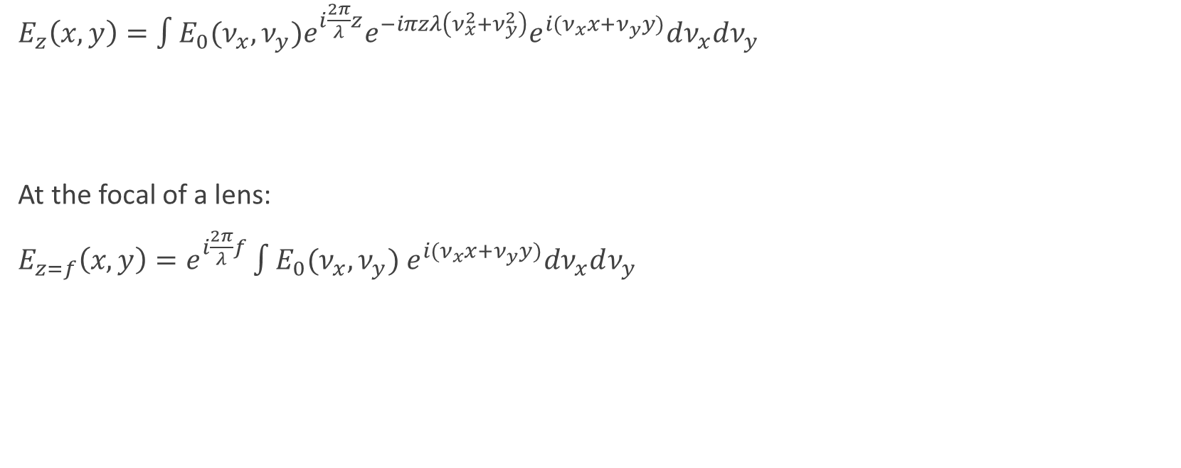
Optical Fourier Transform
$E_{z}\left(x,y\right)=\int{E_{0}(ν_{x},ν_{y})e^{i\frac{2π}{λ}z}e^{−iπzλ\left(ν_{x}^{2}+ν_{y}^{2}\right)}e^{i(ν_{x}x+ν_{y}y)}dν_{x}dν_{y}}$
At the focal of a lens:
$E_{z=f}\left(x,y\right)=e^{i\frac{2π}{λ}f}\int{E_{0}(ν_{x},ν_{y}) e^{i(ν_{x}x+ν_{y}y)}dν_{x}dν_{y}}$
Fourier Operator

Slide 28
Optical Fourier Transform
$E_{z}\left(x,y\right)=\int{E_{0}(ν_{x},ν_{y})e^{i\frac{2π}{λ}z}e^{−iπzλ\left(ν_{x}^{2}+ν_{y}^{2}\right)}e^{i(ν_{x}x+ν_{y}y)}dν_{x}dν_{y}}$
At the focal of a lens:
$E_{z=f}\left(x,y\right)=e^{i\frac{2π}{λ}f}\int{E_{0}(ν_{x},ν_{y}) e^{i(ν_{x}x+ν_{y}y)}dν_{x}dν_{y}}$
Fourier Operator
We got the Fourier transform of $E_{0}$ at the focal of the lens

Slide 29
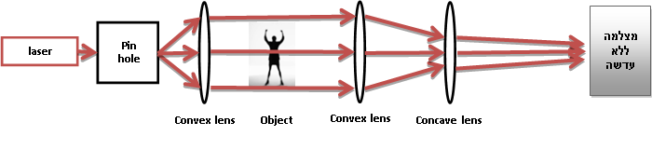
Imaging the Fourier Plane
Camera
Create Plane wave
Imaging

Slide 30
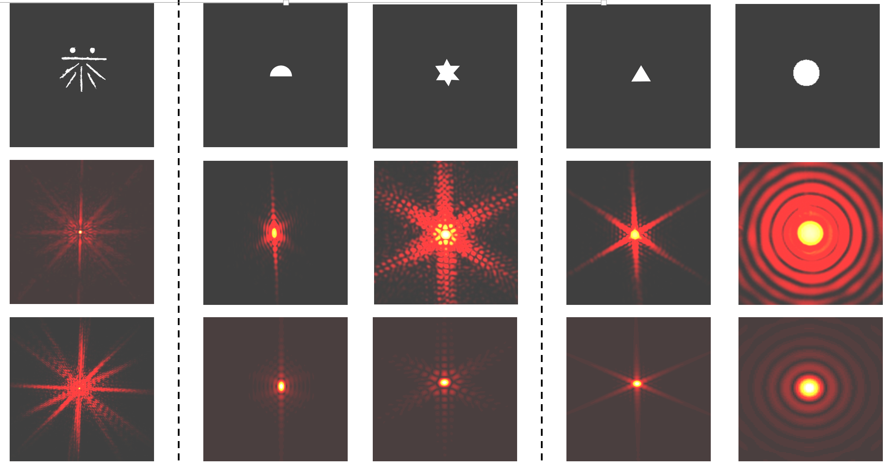

Slide 31
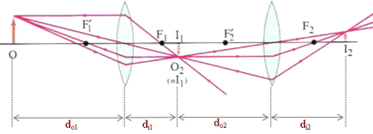
4-f System

Slide 32
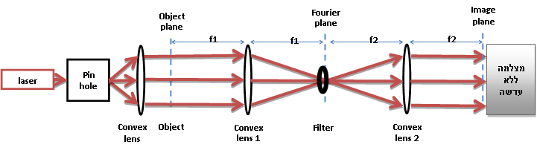
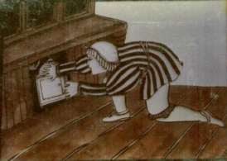
Optical Filtering
Camera

Slide 33
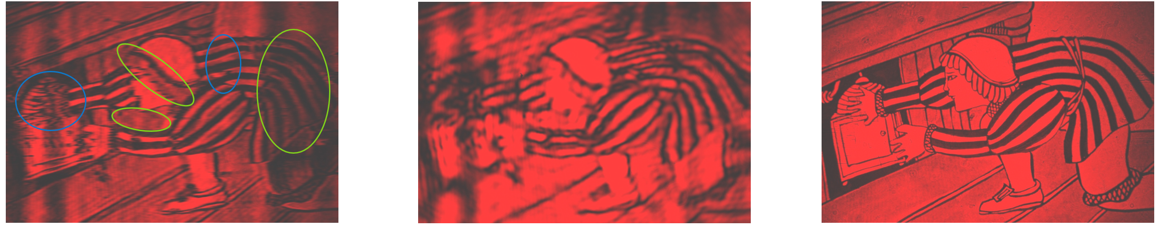
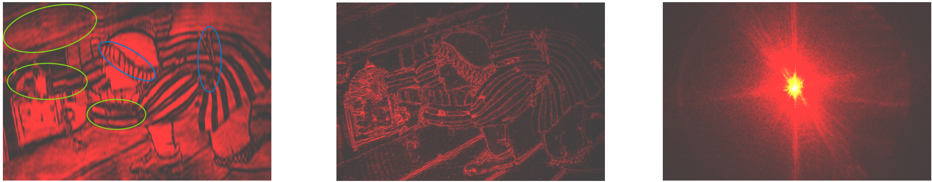
Horizontal Low Pass Filter
Low Pass Filter
Original Image
Vertical Low Pass Filter
High Pass Filter
Optical Fourier Transform

Slide 34
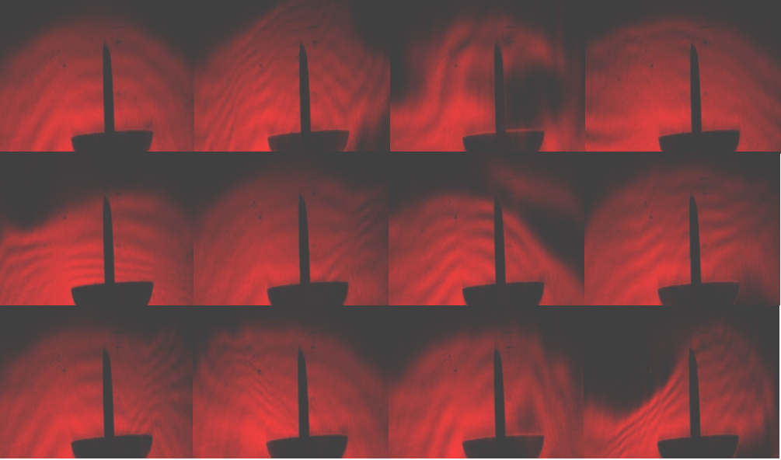
Schlieren Filter
Block half Fourier plane

Slide 35
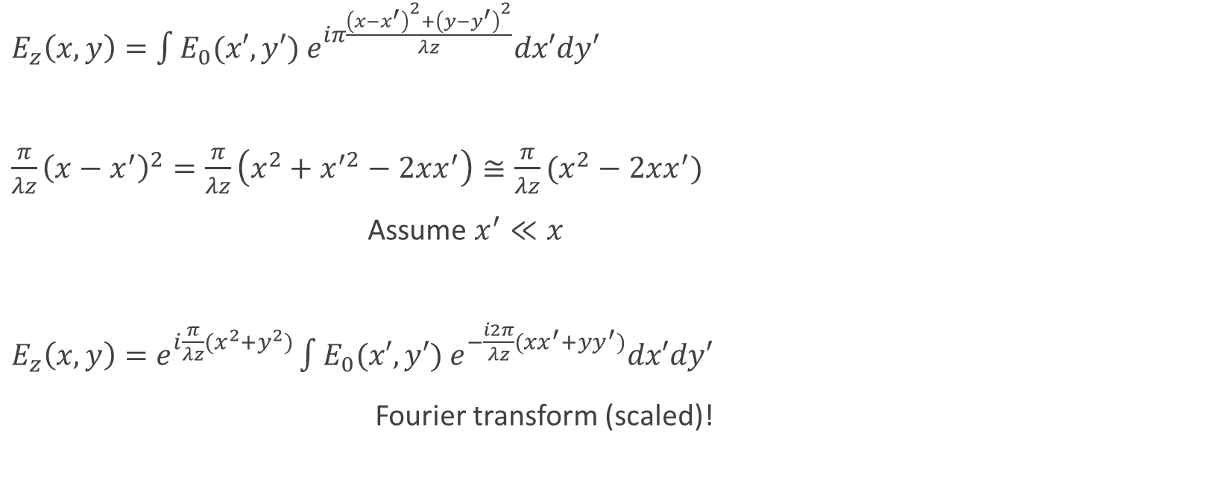
Fraunhofer Approximation
$E_{z}\left(x,y\right)=\int{E_{0}(x′,y′) e^{iπ\frac{{\left(x−x^{′}\right)}^{2}+{\left(y−y^{′}\right)}^{2}}{λz}}dx′dy′}$
$\frac{π}{λz}{\left(x−x^{′}\right)}^{2}=\frac{π}{λz}\left(x^{2}+x^{′2}−2xx^{′}\right)≅\frac{π}{λz}(x^{2}−2xx^{′})$
Assume $x^{′}≪x$
$E_{z}\left(x,y\right)=e^{i\frac{π}{λz}(x^{2}+y^{2})}\int{E_{0}(x′,y′) e^{−\frac{i2π}{λz}(xx^{′}+yy^{′})}dx′dy′}$
Fourier transform (scaled)!

Slide 36
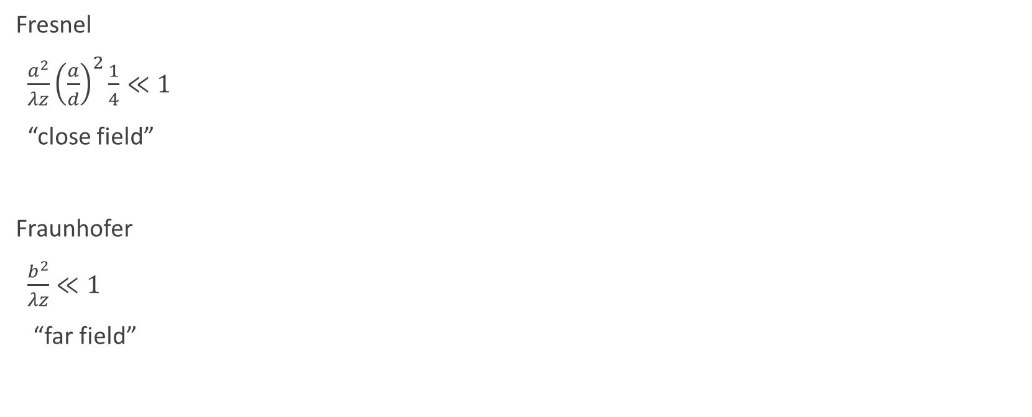
Fresnel and Fraunhofer Approximations
Fresnel
$\frac{a^{2}}{λz}{\left(\frac{a}{d}\right)}^{2}\frac{1}{4}≪1$
“close field”
Fraunhofer
$\frac{b^{2}}{λz}≪1$
“far field”
a
b
z

Slide 37
Diffraction

Slide 38
Optical Signal Processing

Slide 39
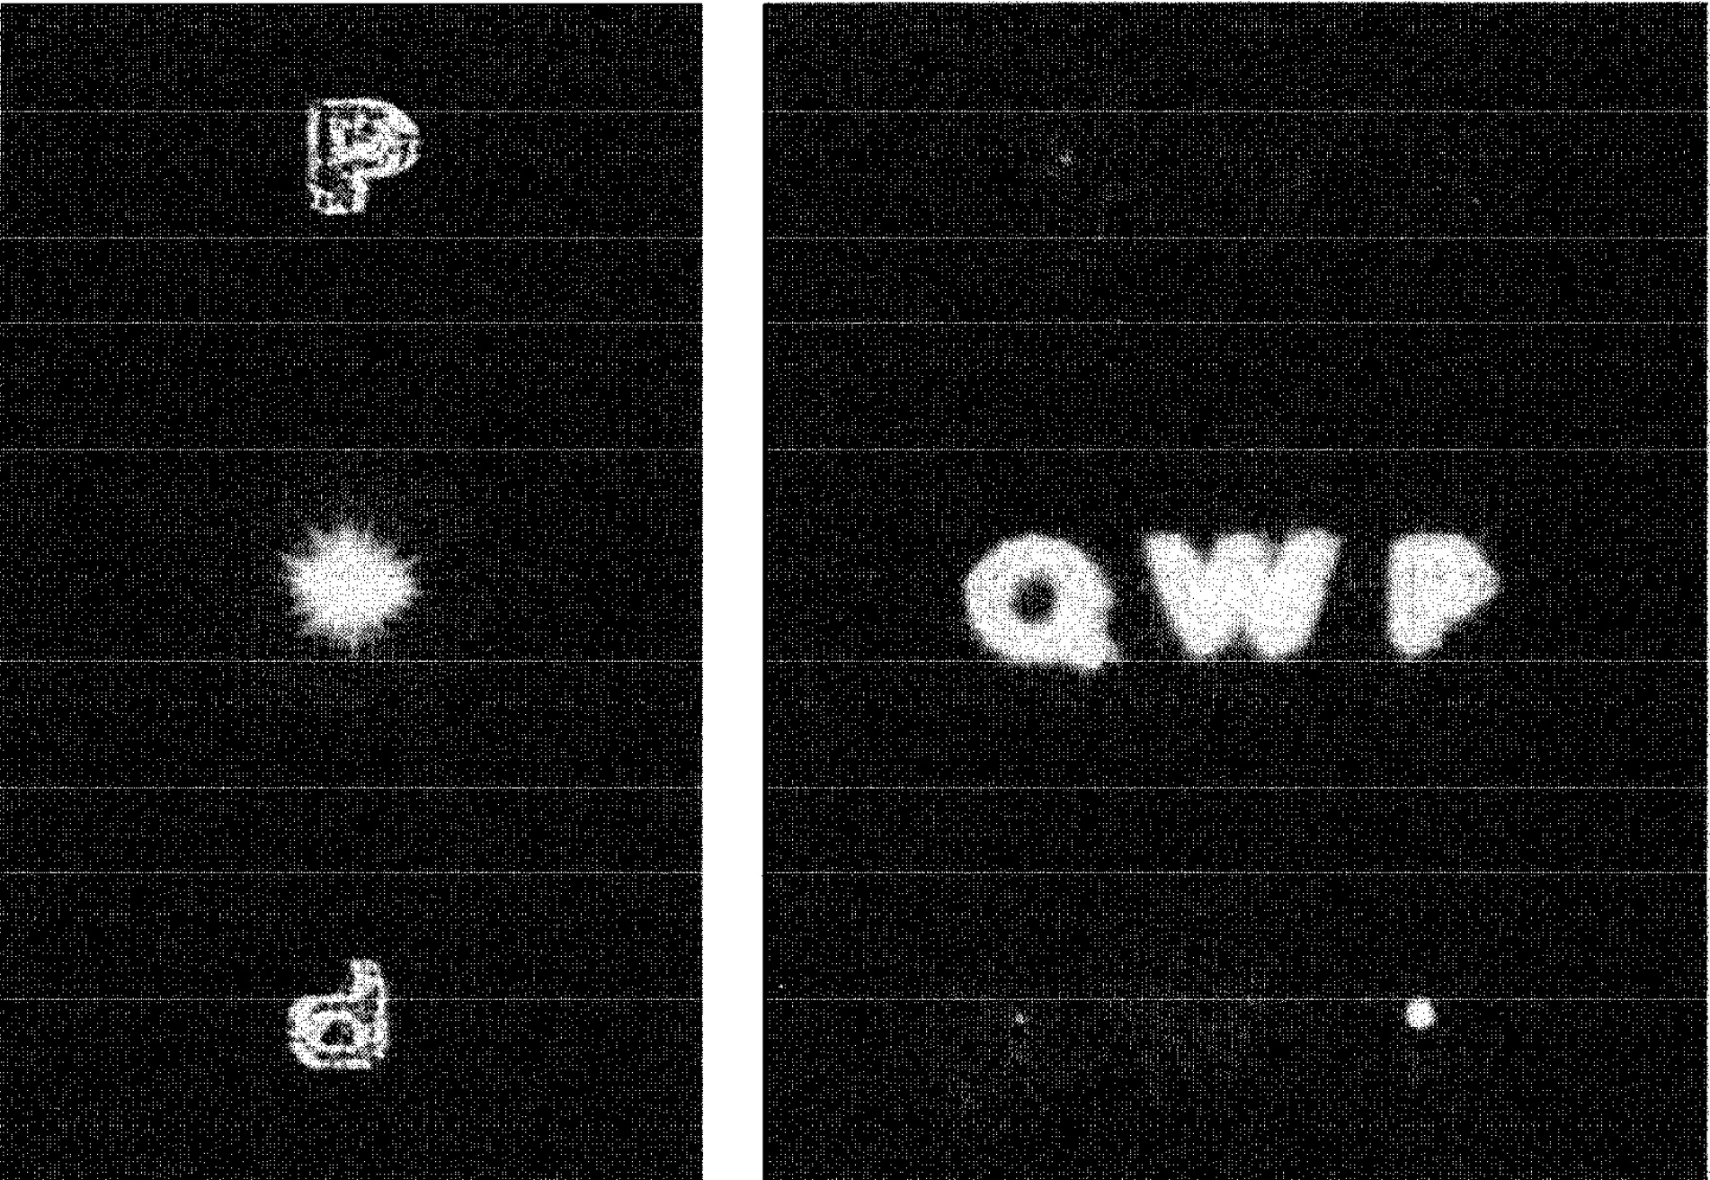
Character Detection with Pure Optics

Slide 40
Ray Optics
Let’s assume large features

Slide 41
Fermat’s Principle
Light travels in the *fastest* path

Slide 42
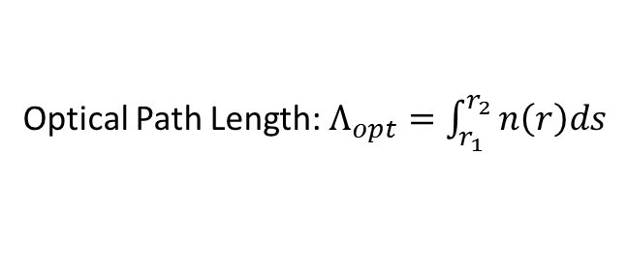
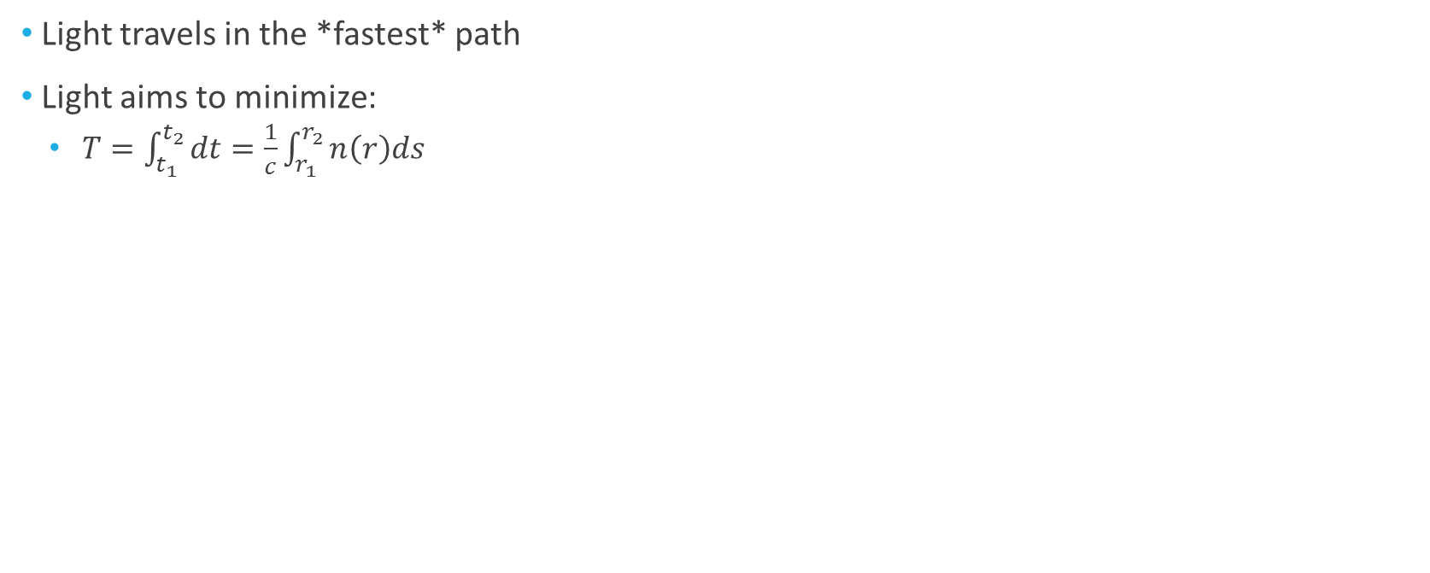
Fermat’s Principle
Light travels in the *fastest* path
Light aims to minimize:
$T=\int_{t_{1}}^{t_{2}}{dt}=\frac{1}{c}\int_{r_{1}}^{r_{2}}{n\left(r\right)ds}$
Optical Path Length: $Λ_{opt}=\int_{r_{1}}^{r_{2}}{n\left(r\right)ds}$

Slide 43
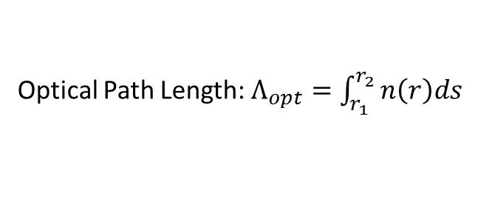
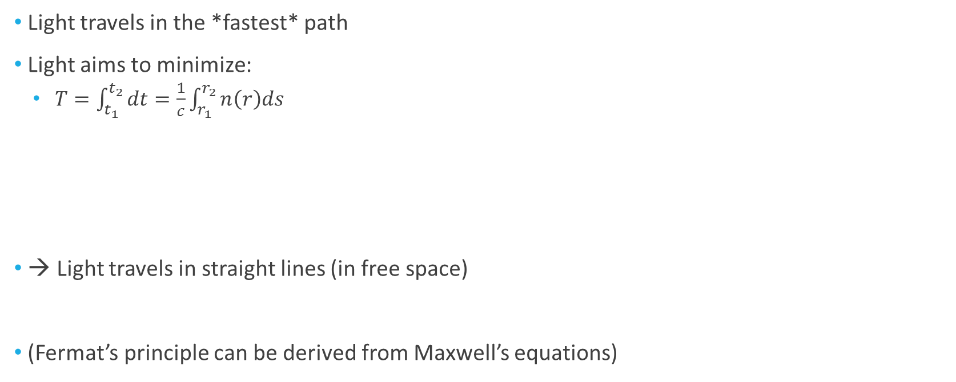
Fermat’s Principle
Light travels in the *fastest* path
Light aims to minimize:
$T=\int_{t_{1}}^{t_{2}}{dt}=\frac{1}{c}\int_{r_{1}}^{r_{2}}{n\left(r\right)ds}$
→ Light travels in straight lines (in free space)
(Fermat’s principle can be derived from Maxwell’s equations)
Optical Path Length: $Λ_{opt}=\int_{r_{1}}^{r_{2}}{n\left(r\right)ds}$

Slide 44
Snell’s Law
A
d
a
θ
d−x
x
b
θ′
B

Slide 45
Snell’s Law
A
d
a
θ
d−x
x
b
θ′
Snel’s law
B

Slide 46
Planar Mirror
A
B
a
θ
θ′
b
x
d−x
d

Slide 47
Planar Mirror
A
B
a
θ
θ′
b
x
d−x
d

Slide 48
A More General Case
Requires calculus of variations
Euler – Lagrange equations provide a solution framework (see later in the course):

Slide 49
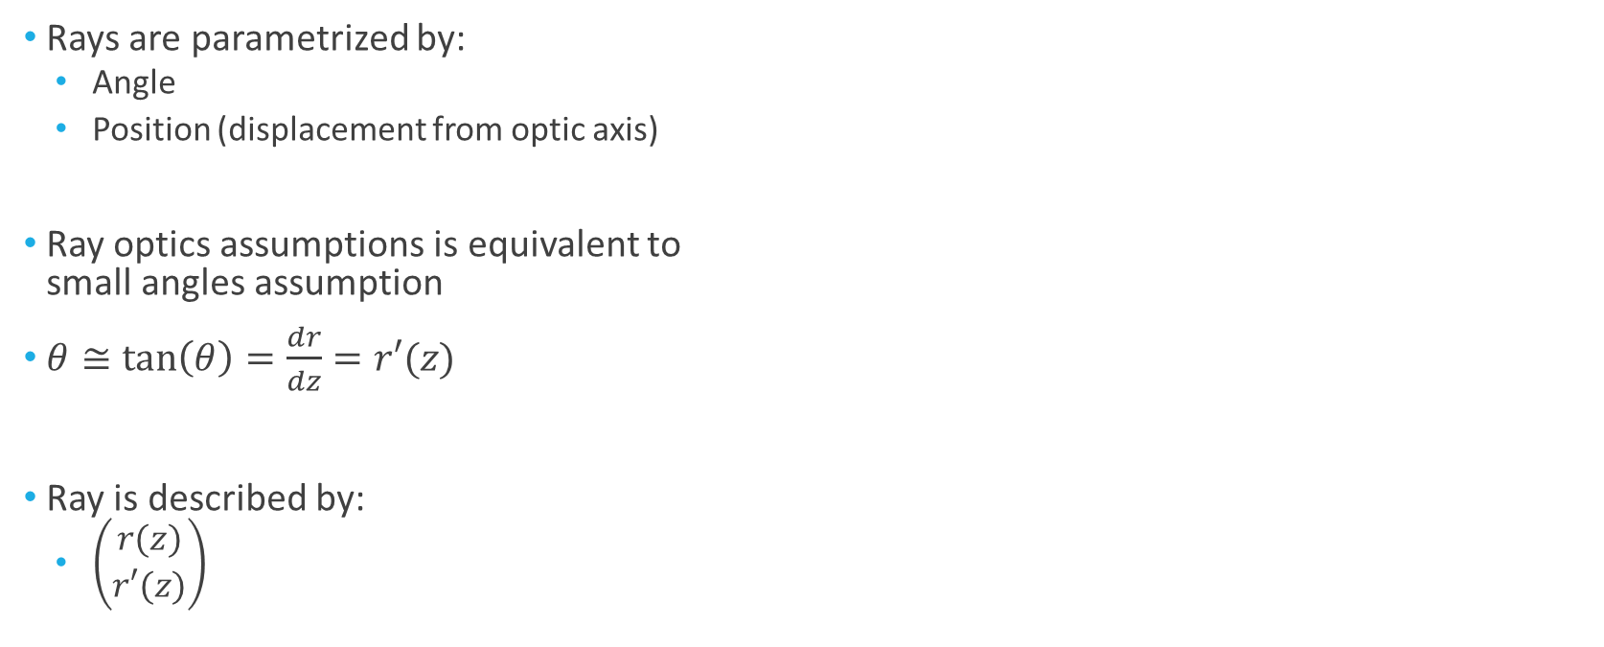
Matrix Optics
Rays are parametrized by:
Angle
Position (displacement from optic axis)
Ray optics assumptions is equivalent to small angles assumption
$θ≅\tan\left(θ\right)=\frac{dr}{dz}=r′(z)$
Ray is described by:
$\left(\begin{matrix}r(z) \\ r′(z)\end{matrix}\right)$
r
z
θ

Slide 50
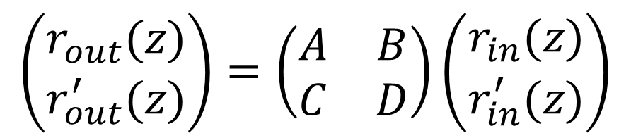
Matrix Optics
$$\left(\begin{matrix}r_{out}(z) \\ r_{out}^{′}(z)\end{matrix}\right)=\left(\begin{matrix}A & B \\ C & D\end{matrix}\right)\left(\begin{matrix}r_{in}(z) \\ r_{in}^{′}(z)\end{matrix}\right)$$

Slide 51
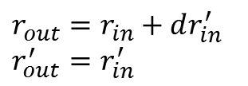
Ray Transfer Matrix
Free space:
d
$$r_{out}=r_{in}+dr_{in}^{′}$$
$$r_{out}^{′}=r_{in}^{′}$$

Slide 52
Ray Transfer Matrix
Free space:
Planar boundary
d
n₁
n₂
$$r_{out}=r_{in}+dr_{in}^{′}$$
$$r_{out}^{′}=r_{in}^{′}$$
Snell’s Law

Slide 53
Ray Transfer Matrix
Spherical boundary
R
n₁
n₂
Convex, R > 0; concave, R < 0

Slide 54
Thin Lens

Slide 55
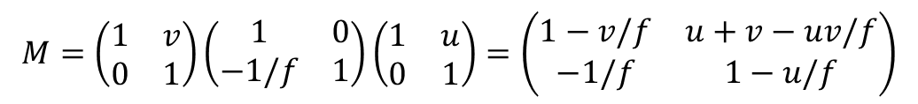
Imaging
f
u
v
$$M=\left(\begin{matrix}1 & v \\ 0 & 1\end{matrix}\right)\left(\begin{matrix}1 & 0 \\ −1/f & 1\end{matrix}\right)\left(\begin{matrix}1 & u \\ 0 & 1\end{matrix}\right)=\left(\begin{matrix}1−v/f & u+v−uv/f \\ −1/f & 1−u/f\end{matrix}\right)$$

Slide 56
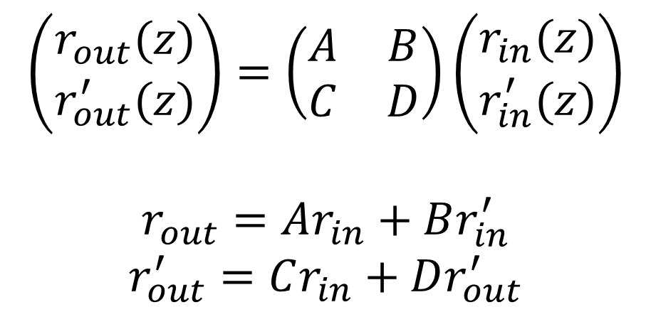
Imaging
$$\left(\begin{matrix}r_{out}(z) \\ r_{out}^{′}(z)\end{matrix}\right)=\left(\begin{matrix}A & B \\ C & D\end{matrix}\right)\left(\begin{matrix}r_{in}(z) \\ r_{in}^{′}(z)\end{matrix}\right)$$
$$r_{out}=Ar_{in}+Br_{in}^{′}$$
$$r_{out}^{′}=Cr_{in}+Dr_{out}^{′}$$
3
2
1
r_{out}
1
2
3
r_{in}
z_{in} z_{out}

Slide 57
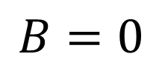
Imaging
$$\left(\begin{matrix}r_{out}(z) \\ r_{out}^{′}(z)\end{matrix}\right)=\left(\begin{matrix}A & B \\ C & D\end{matrix}\right)\left(\begin{matrix}r_{in}(z) \\ r_{in}^{′}(z)\end{matrix}\right)$$
$$r_{out}=Ar_{in}+Br_{in}^{′}$$
$$r_{out}^{′}=Cr_{in}+Dr_{out}^{′}$$
3
2
1
r_{out}
1
2
3
r_{in}
z_{in} z_{out}
$$B=0$$

Slide 58
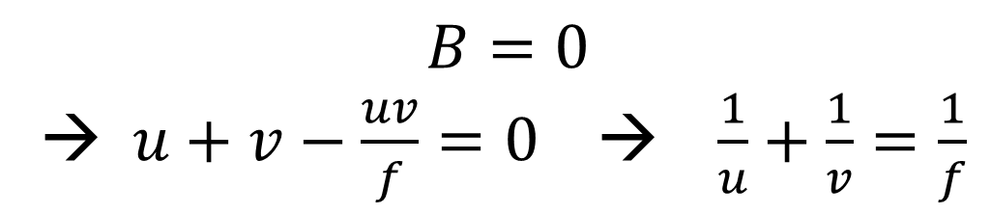
Imaging with a lens
f
u
v
$$M=\left(\begin{matrix}1 & v \\ 0 & 1\end{matrix}\right)\left(\begin{matrix}1 & 0 \\ −1/f & 1\end{matrix}\right)\left(\begin{matrix}1 & u \\ 0 & 1\end{matrix}\right)=\left(\begin{matrix}1−v/f & u+v−uv/f \\ −1/f & 1−u/f\end{matrix}\right)$$
$$B=0$$
→ $u+v−\frac{uv}{f}=0$ → $\frac{1}{u}+\frac{1}{v}=\frac{1}{f}$

Slide 59
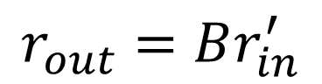
A=0
$$r_{out}=Br_{in}^{′}$$
1
2
3
1
2
3
r_{out}
z_{in} z_{out}
Focus (each angle is mapped to different location)

Slide 60


B=0
$$r_{out}=Ar_{in}$$
3
2
1
r_{out}
1
2
3
r_{in}
z_{in} z_{out}
Imaging with magnification $A$

Slide 61

C=0
$${r′}_{out}=Dr_{in}^{′}$$
1
2
3
1
2
3
z_{in} z_{out}
Telescope – parallel beams remain parallel

Slide 62

D=0
$${r′}_{out}=Cr_{in}$$
1
2
3
1
2
3
r_{in}
z_{in} z_{out}
Collimation – Point source is mapped to parallel beams

Slide 63


Mirage

